Slide 1

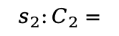





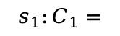
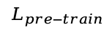
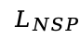

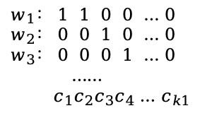

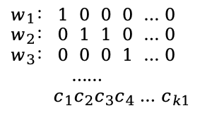



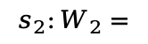




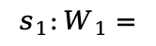
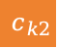
$$s_{1}:C_{1}=$$
.......
embedding
encoder
encoder
output
fine-tune
$$c_{1}$$
$$c_{2}$$
$$c_{3}$$
$$c_{4}$$
$$c_{k1}$$
gate
gate
$$s_{2}:C_{2}=$$
.......
....
$$L_{NSP}$$
Docs
$$c_{1}$$
$$c_{2}$$
$$c_{3}$$
$$c_{4}$$
$$c_{k2}$$
attn
attn
Hanlp
切词
....
Word
List
$$s_{1}:W_{1}=$$
$$w_{1}$$
$$w_{2}$$
$$w_{3}$$
.......
$$w_{n1}$$
embedding
encoder
encoder
pre-train
.......
....
$$s_{2}:W_{2}=$$
$$w_{1}$$
$$w_{2}$$
$$w_{3}$$
$$w_{n2}$$
....
$$L_{pre−train}$$
$$w_{1}： 1 0 0 0 … 0$$
$$w_{2}： 0 1 1 0 … 0$$
$$w_{3}： 0 0 0 1 … 0$$
……
$${ c}_{1}c_{2}c_{3}c_{4} …{ c}_{k1}$$
$$w_{1}： 1 1 0 0 … 0$$
$$w_{2}： 0 0 1 0 … 0$$
$$w_{3}： 0 0 0 1 … 0$$
……
$${ c}_{1}c_{2}c_{3}c_{4} …{ c}_{k1}$$
....
....
$$М_{1}$$
$$М_{2}$$

Slide 2
fine-tune head
PolicyBERT
BGE-base-zh-v1.5
BGE-merged
BERT
BERT
character encode
character encode
fusion
layer
WeiMingPolicyQA
ZEN-pretrain-base

